Slide 1


MRA Project ML 1
R.BALASUBRAMANIYAM

Slide 2
Agenda To Perform RFM and find suitable insights about the automobile parts manufacturing company data and segment their customers.
Contents of the presentation
Problem statement
Exploratory Analysis and Inferences
Customer Segmentation using RFM analysis (4 segments)
Inferences from RFM Analysis and identified segments

Slide 3
Problem statement
An automobile parts manufacturing company has collected data of transactions for 3 years. They do not have any in-house data science team; thus, they have hired you as their consultant. Your job is to use your magical data science skills to provide them with suitable insights about their data and their customers.

Slide 4
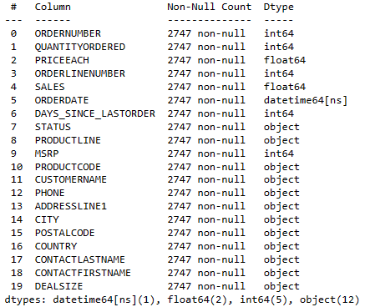
Data shape No. rows-2747 No. columns-20
About Data
Descriptive Summary
 | ORDERNUMBER | QUANTITY ORDERED | PRICEEACH | ORDER LINENUMBER | SALES | DAYS_SINCE_LASTORDER | MSRP
count | 2747 | 2747 | 2747 | 2747 | 2747 | 2747 | 2747
mean | 10259.76156 | 35.103021 | 101.09895 | 6.491081 | 3553.04758 | 1757.08591 | 100.69166
std | 91.877521 | 9.762135 | 42.042548 | 4.230544 | 1838.9539 | 819.280576 | 40.114802
min | 10100 | 6 | 26.88 | 1 | 482.13 | 42 | 33
25% | 10181 | 27 | 68.745 | 3 | 2204.35 | 1077 | 68
50% | 10264 | 35 | 95.55 | 6 | 3184.8 | 1761 | 99
75% | 10334.5 | 43 | 127.1 | 9 | 4503.095 | 2436.5 | 124
max | 10425 | 97 | 252.87 | 18 | 14082.8 | 3562 | 214
Data Assumptions
No duplicate rows are present in the dataset.
No null values are present in the dataset.
The count of order number is considered as the frequency of a customer for RFM analysis.
The recency is calculated from 2020-05-30 to the customer order date.
Data Information

Slide 5


Slide 6
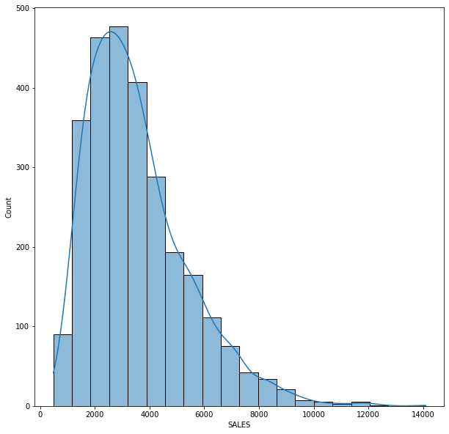
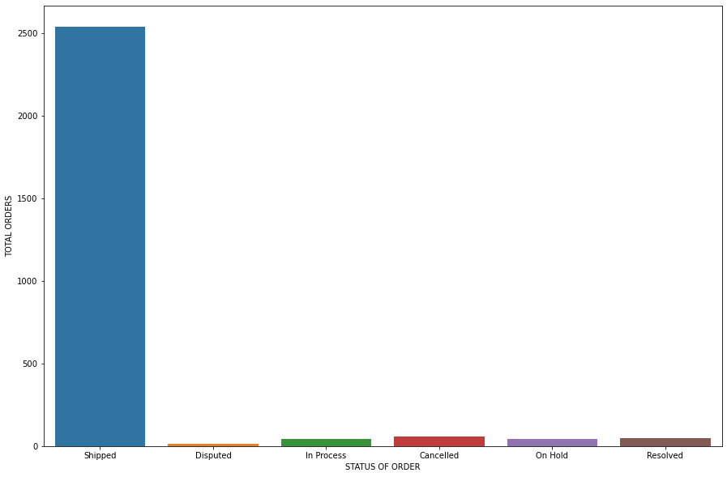
UNIVARIATE ANALYSIS:
SALES
STATUS OF SHIPMENT

Slide 7
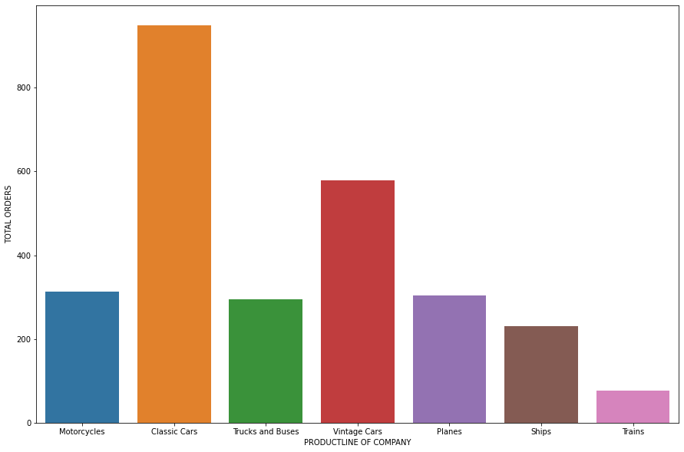

Slide 8
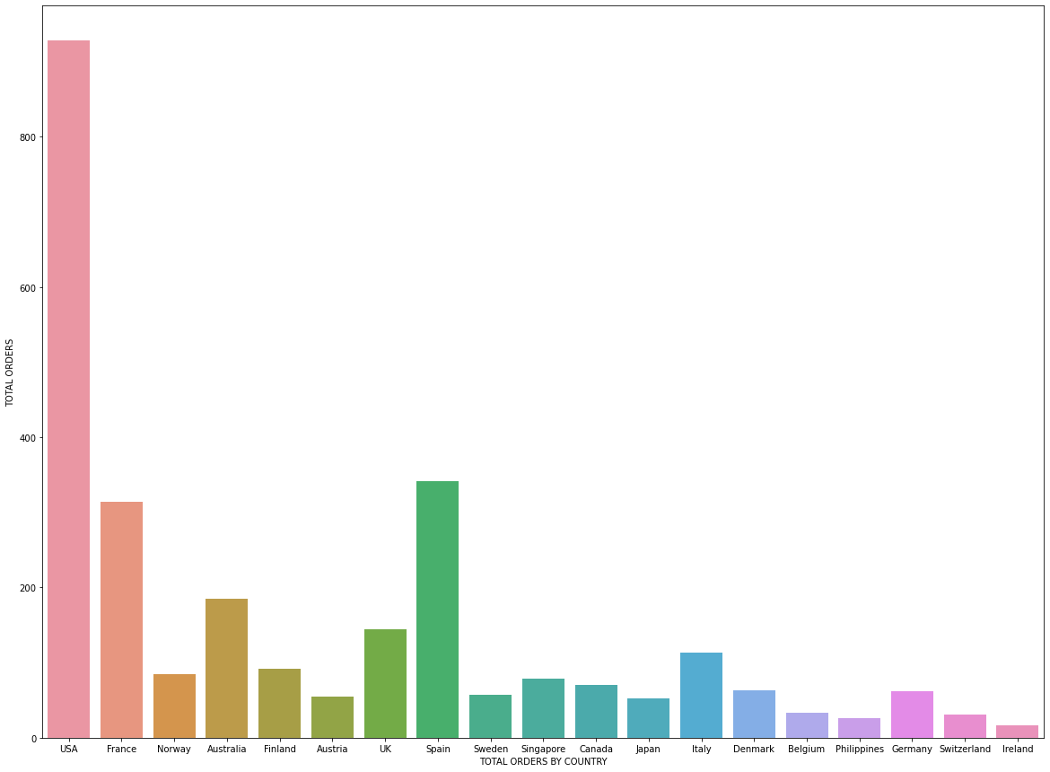

Slide 9
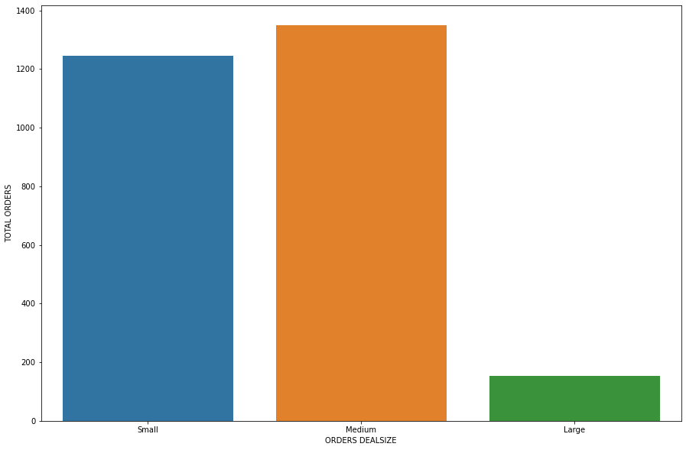

Slide 10
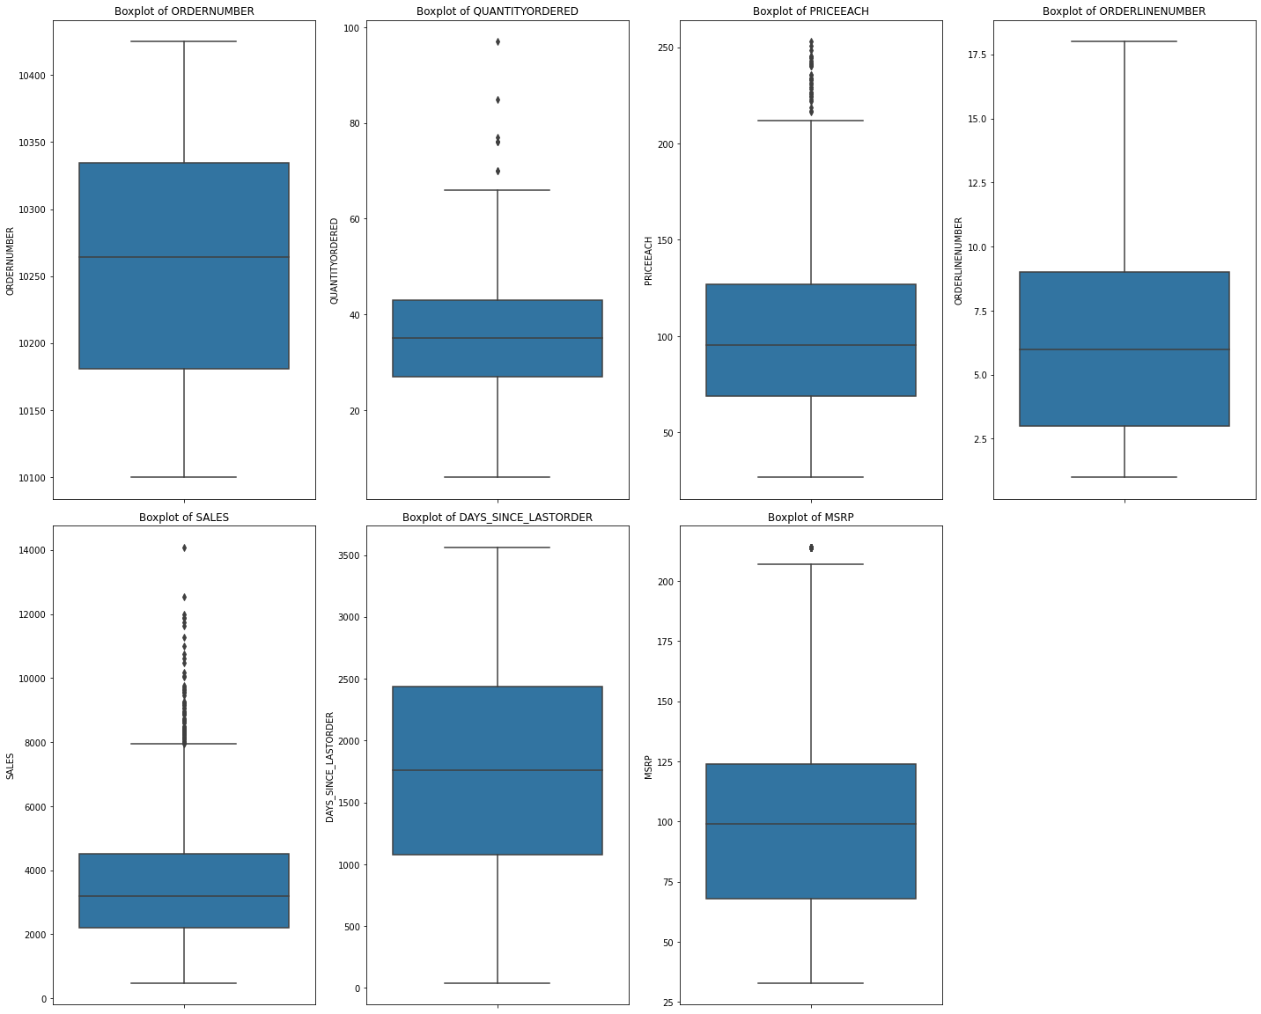
OUTLIER IDENTIFICATION
Outliers are present in the Quantity ordered, Price each, Sales amount, MSRP.
In order to capture the true customer behavior in our analysis, we are proceeding without treating these outliers.

Slide 11
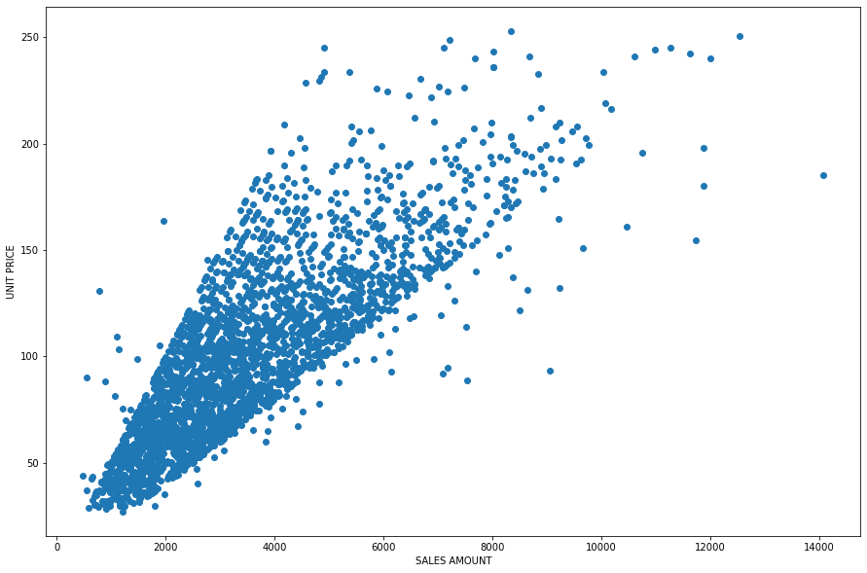
BIVARIATE ANALYSIS:
SALES VS UNIT PRICE
As the unit value increases the sale amount also increases.
From the plot it is observed that more products sold are having unit price less than 150 and constitutes to majority of sales.

Slide 12
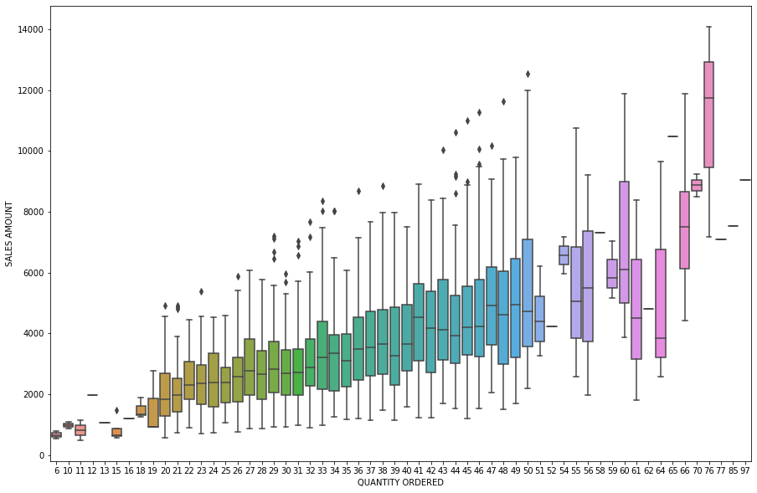
SALES VS QTY ORDERED
Plot indicates the sales amount of certain products are higher when the quantity ordered is higher
Products ordered in 50 quantity has good spread in the sales amount comparatively.

Slide 13
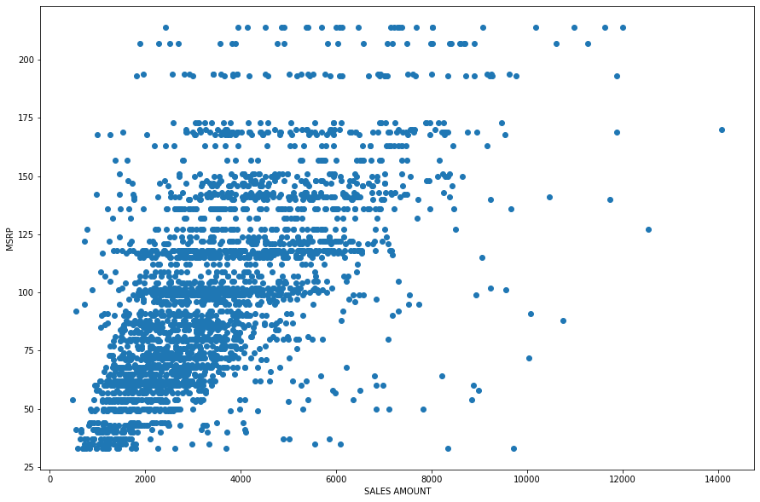
SALES VS MSRP
The products with MSRP less than 150 are having good sales numbers and good sales values.

Slide 14
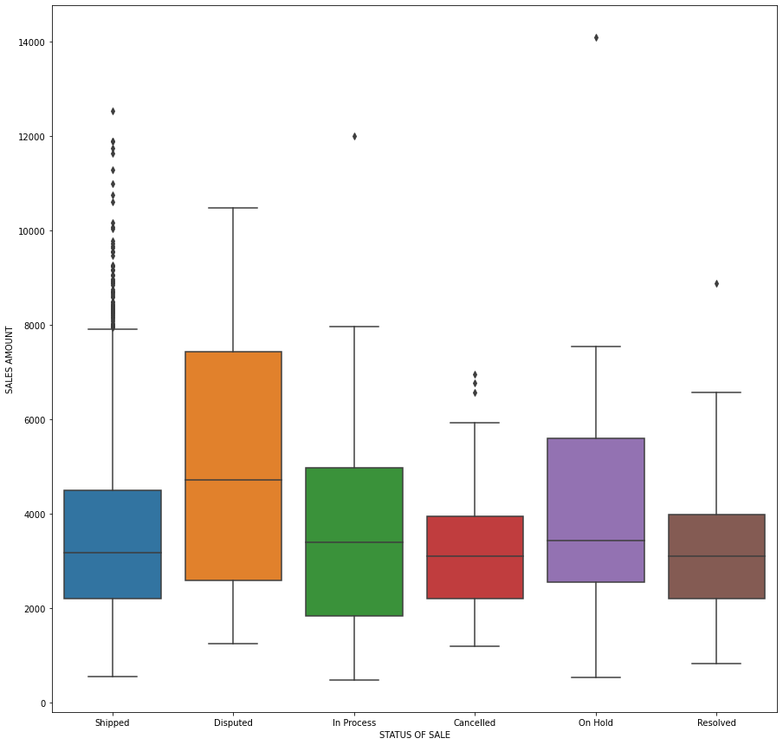
SALES VS SHIPMENT STATUS
Most of the products with sales value from 500 to 12000 are shipped.
There is a considerable quantity of high value products at disputed, on hold status.
The disputed and on hold products need to be resolved ASAP to get good sales value.

Slide 15
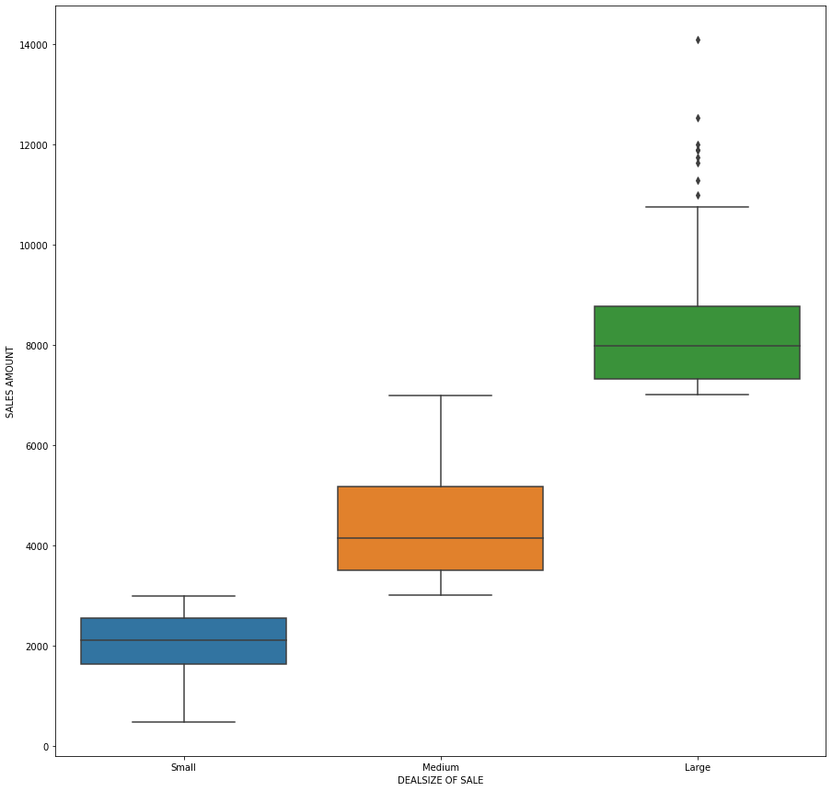
SALES VS DEALSIZE
The Large deal size are making good sales returns in the range of (7000 to 11500).
The Medium deal size are making good sales returns in the range of (3000 to 7000).
The Small deal size are making less sales returns in the range of (500 to 3000).

Slide 16
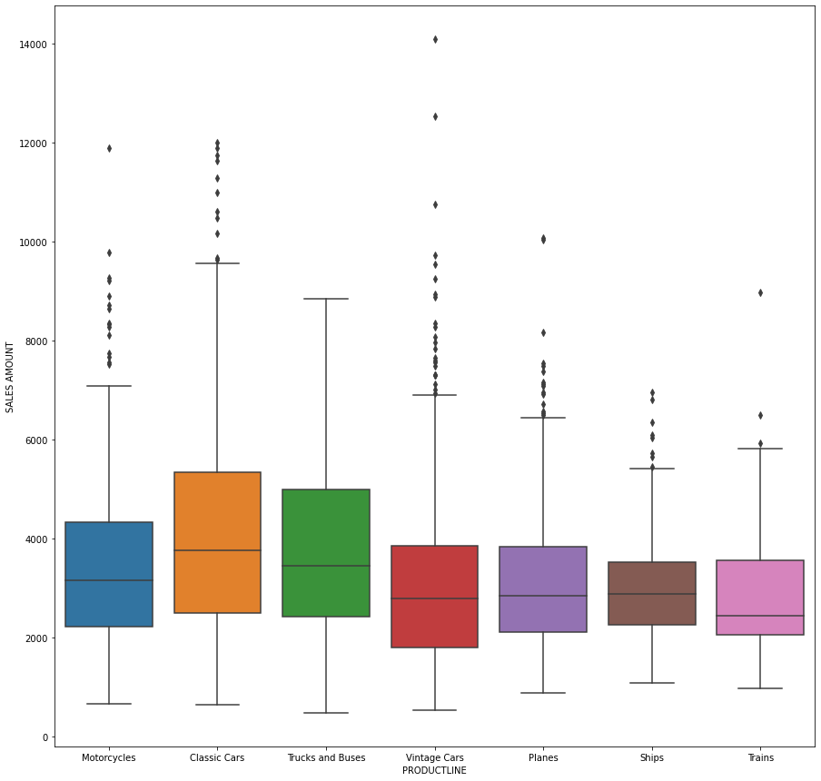
SALES VS PRODUCT LINE
The Classic cars product line is having very good sales amount.
Secondly the trucks and buses are having good sales amount.
Motorcycles and vintage cars are having third and fourth positions in terms of total sales value.

Slide 17
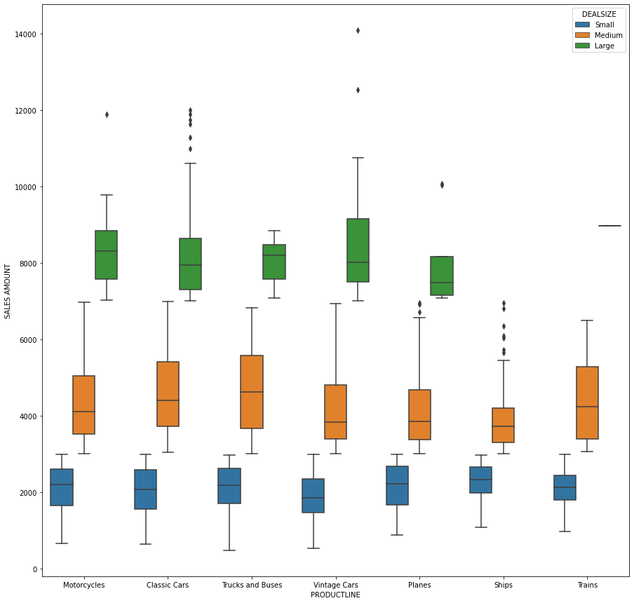
MULTIVARIATE ANALYSIS:
SALES VS DEALSIZE VS PRODUCT LINE
The plot gives us an idea about the sales value of different product lines based on the deal size.
The ships and trains product lines are not having any large size deals.
Vintage cars are having more large size deals compared to other products.

Slide 18
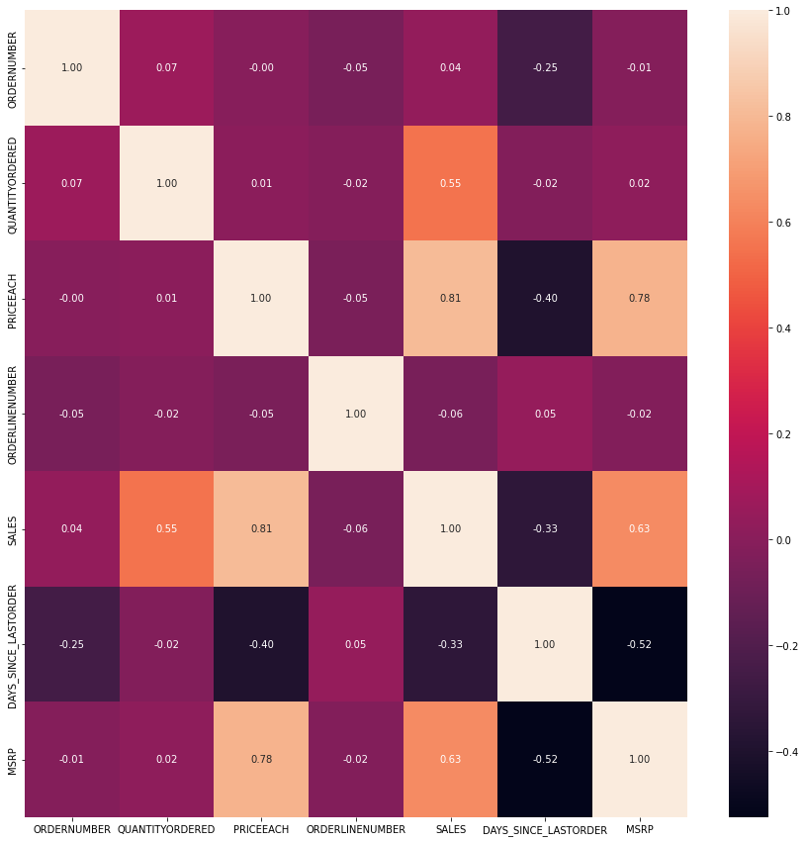
CORRELATION HEATMAP
The heat map is used to analyze the correlation between the different features of our dataset.
Price is 81% correlated to sales and 78% to MSRP.
Sales is 63% correlated to MSRP and 55% to Quantity ordered.
All other features are not having any significant correlation with each other.

Slide 19
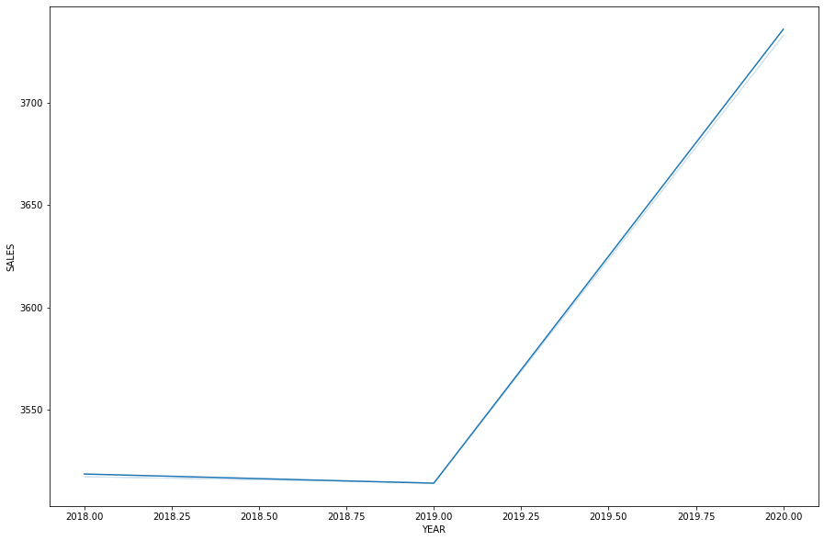
SALES VS ORDER YEAR
The overall trend looks like the sales amount have increased over the year.
It has sharply increased from 2019 and steadily increasing till 2020.

Slide 20
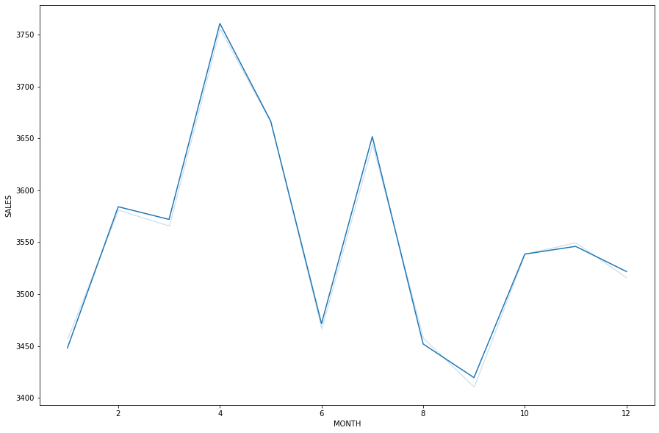
SALES VS ORDER MONTH
From the sale vs order month plot it is clear there is seasonality in the dataset.
The sales value starts increasing from march month till mid-April .
After April month the sales declines and again increases from June to July.

Slide 21
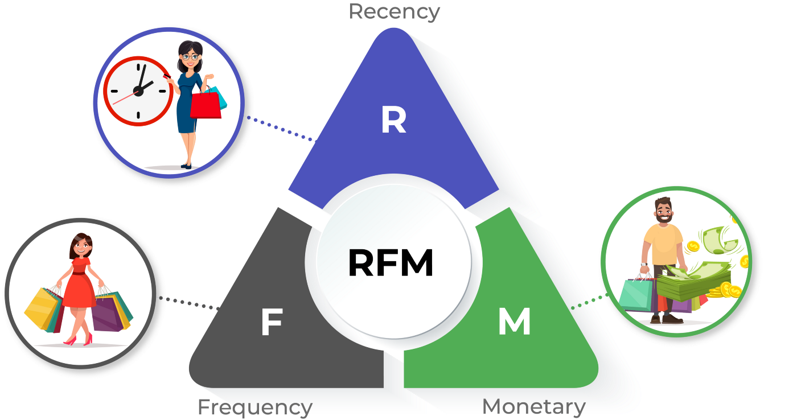
Customer Segmentation using RFM analysis

Slide 22
What is RFM?
RFM analysis is a marketing technique used to quantitatively rank and group customers based on the recency, frequency and monetary total of their recent transactions to identify the best customers and perform targeted marketing campaigns. The system assigns each customer numerical scores based on these factors to provide an objective analysis.
Here RFM analysis is carried out by using KNIME analytics platform.

Slide 23
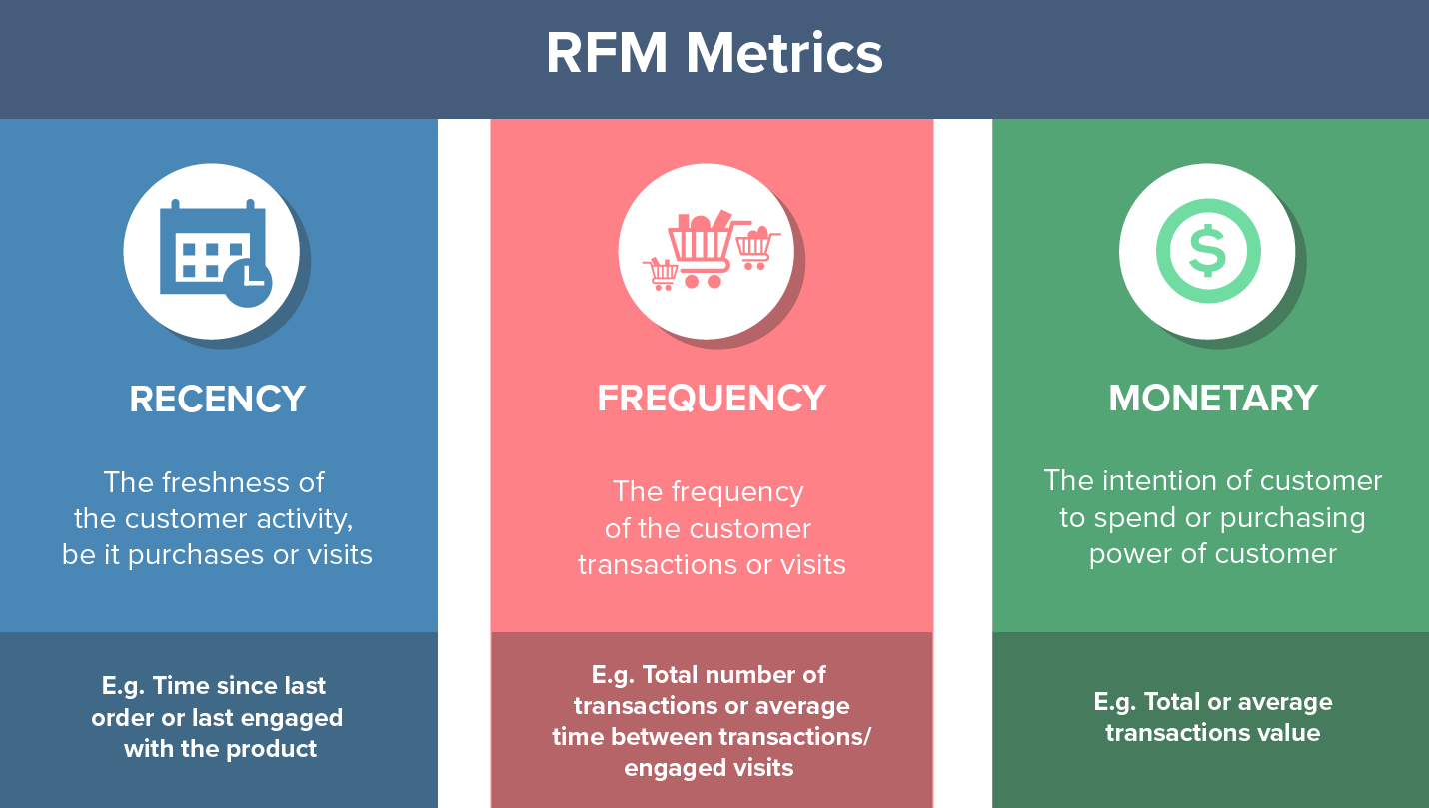
parameters used and assumptions made
Recency – How recent was the customer's last purchase?
Frequency – How often did this customer make a purchase in a given period?
Monetary – How much money did the customer spend in a given period?
The recency is calculated from 2020-05-30 to the customer order date.
The count of order number is considered as the frequency of a customer for RFM analysis.
Monetary is the total sales value of a customer.

Slide 24
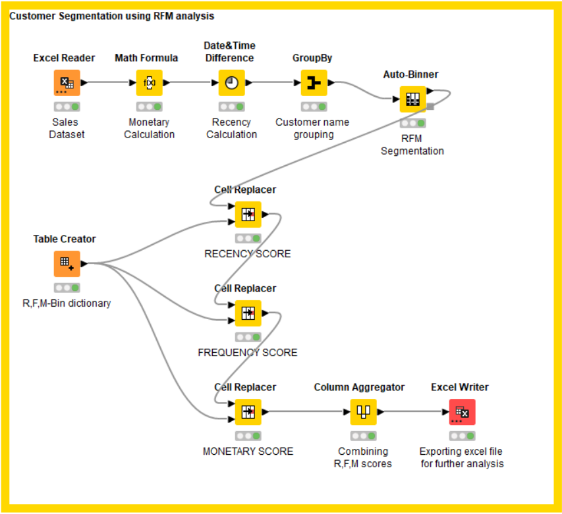
KNIME Workflow
RFM analysis is performed using
the Customer Name in KNIME.
4 Customer bins are created,
Bin1 (0%-25%), Bin2 (25%-50%),
Bin3 (50%-75%), Bin4 (75%-100%).

Slide 25
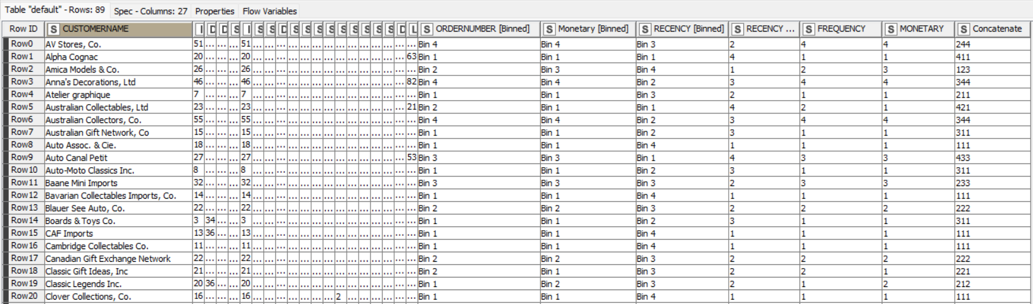
Output table head from knime
R, F, M bins are created and combined after assigning proper scores.

Slide 26
customer segments
Best customers
Customers at risk (Churn possibility)
Lost customers
Loyal customers

Slide 27

Who are your best customers?
Euro Shopping Channel
Mini Gifts Distributors Ltd.
La Rochelle Gifts
The Sharp Gifts Warehouse
Souveniers And Things Co.

Slide 28

Which customers are on the verge of churning?
Baane Mini Imports
Cruz & Sons Co.
Heintze Collectables
La Corne D'abondance, Co.
Toms Spezialitten, Ltd
Vitachrome Inc.

Slide 29
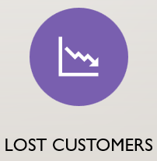
Who are your lost customers?
Bavarian Collectables Imports, Co.
Cambridge Collectables Co.
Double Decker Gift Stores, Ltd
West Coast Collectables Co.
CAF Imports

Slide 30

Who are your loyal customers?
Auto Canal Petit
Oulu Toy Supplies, Inc.
Suominen Souveniers
Tokyo Collectables, Ltd
Toys of Finland, Co.
Toys4GrownUps.com
UK Collectables, Ltd.

Slide 31

insights
EDA INSIGHTS
Classic cars, vintage cars, motorcycles are top 3 product lines ordered by the customer.
The sales in the month of April and June might be due to summer and winter seasons, the company could maintain the inventory accordingly.
Top 3 orders are from USA, Spain, France.
Sales of the company have increased over the years.
RFM INSIGHTS
The best customers (444) are spending an average of 100/unit on our products. They should be targeted with special promotions to keep them active.
At Risk Customers(234) are those who purchased often and spent big amounts but haven’t purchased recently. Send them personalized reactivation campaigns to reconnect.
Lost customers(111) are those who have visited once, long time ago and haven’t spent much on our products. It is better if no promotional efforts are made on getting these customers back.

